Slide 1



Photographic Studio Manager
Website quản lý Studio.

Slide 2
CAPSTONE PROJECT PRESENTATION 卒業論文プレゼンテーション
Hanoi, May 10th, 2018

Slide 3
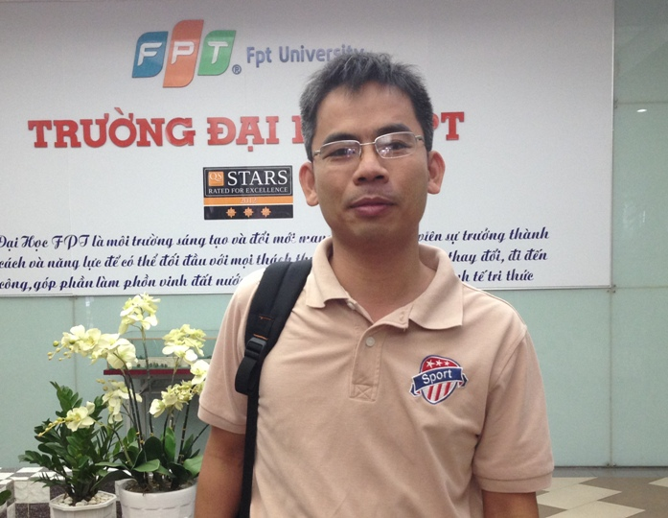
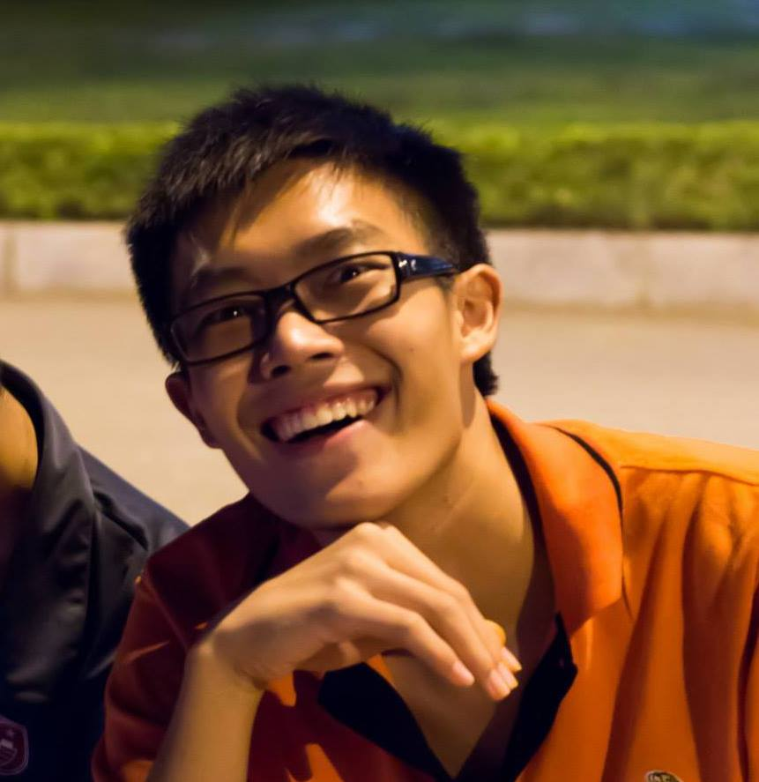
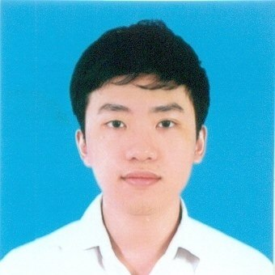
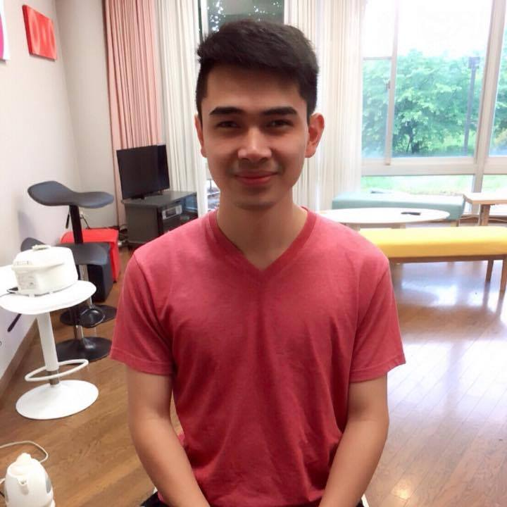
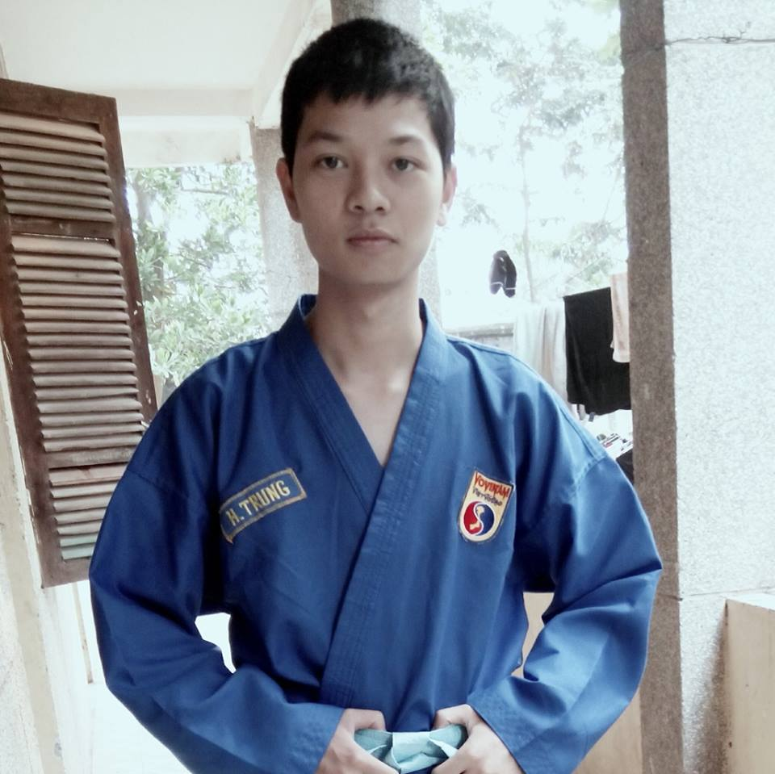
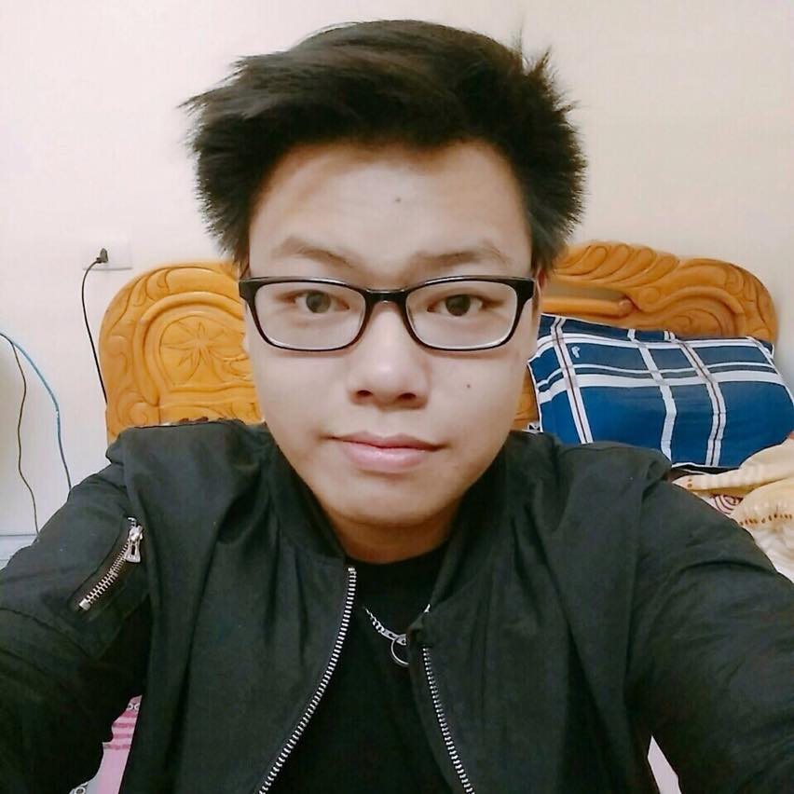
About Us
- PSM Team -
We are a group of 5 FPT University Student. Under the supervision of Prof. Phan Truong Lam, we have finished this capstone project.
Phan Truong Lam
Supervisor
Cao Lam Vu
Member
Nguyen Sy Bach
Member
Nguyen Manh Huy
Leader
Nguyen Hoang Trung
Member
Pham Tuan Dung
Member

Slide 4
Outline アウトライン
1. Introduction イントロダクション
2. Software Project Management プロジェクト管理
3.Software Requirement Specification ソフトウェア要件仕様書
4. Software Design Description ソフトウェア 設計書
5. Software Testing ソフトウェアテスト
6. Lesson Learn 学んだ教訓
7. Demo デモ
8. Q & A 質問と回答

Slide 5

INTRODUCTION イントロダクション

Slide 6

About Our Project
INTRODUCTION

Slide 7
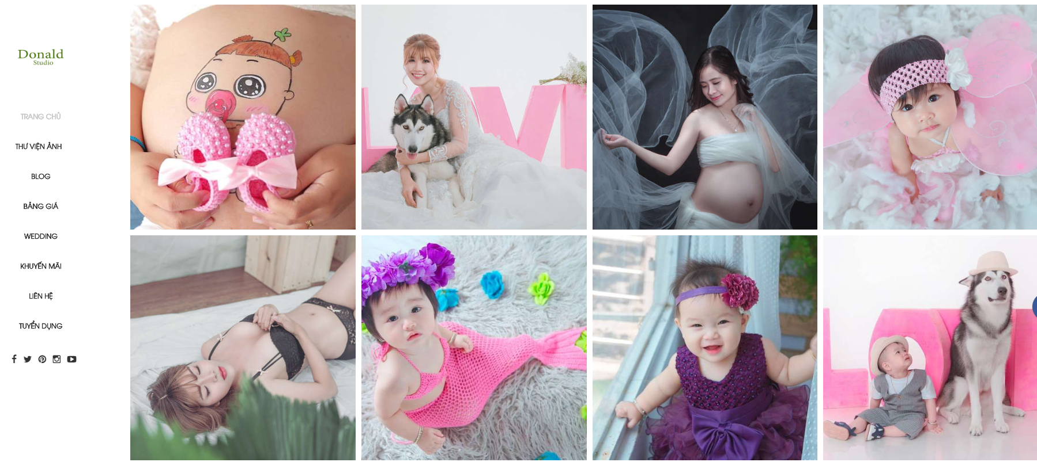
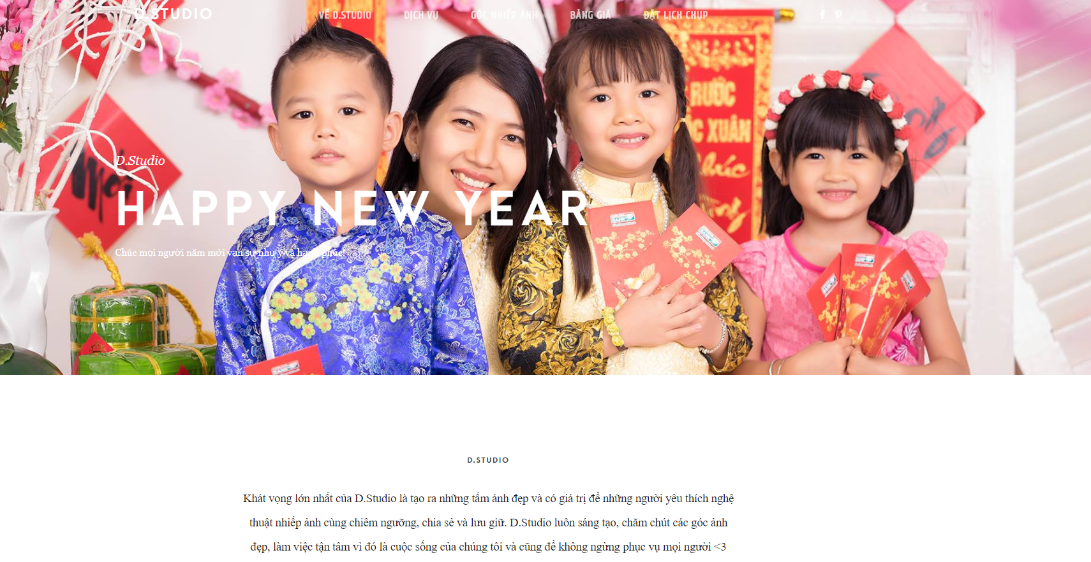
Existing system
INTRODUCTION
Donald Studio (http://donaldstudio.net)
D Studio (http://dstudio.vn)

Slide 8

Idea
INTRODUCTION
“Photographic Studio Manager” is a brand new website systems that include management systems for both managers and customers.

Slide 9

PROJECT MANAGEMENT プロジェクト管理

Slide 10
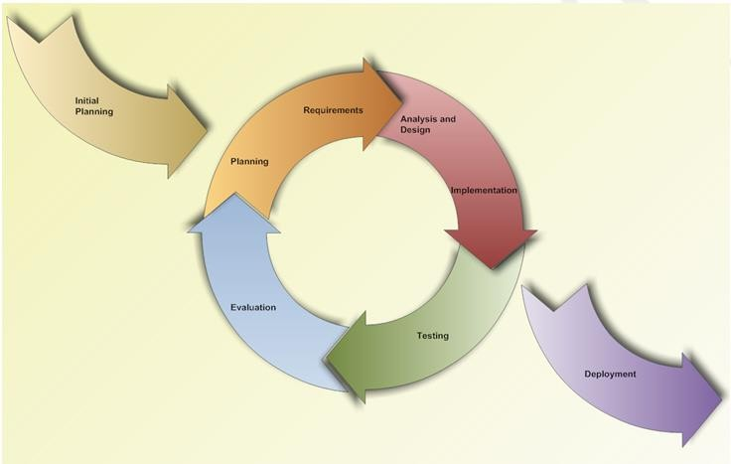
Software development process フトウェア開発のプロセス
PROJECT MANAGEMENT
Iteration 1: Jan 11th – Mar 25th

Slide 11
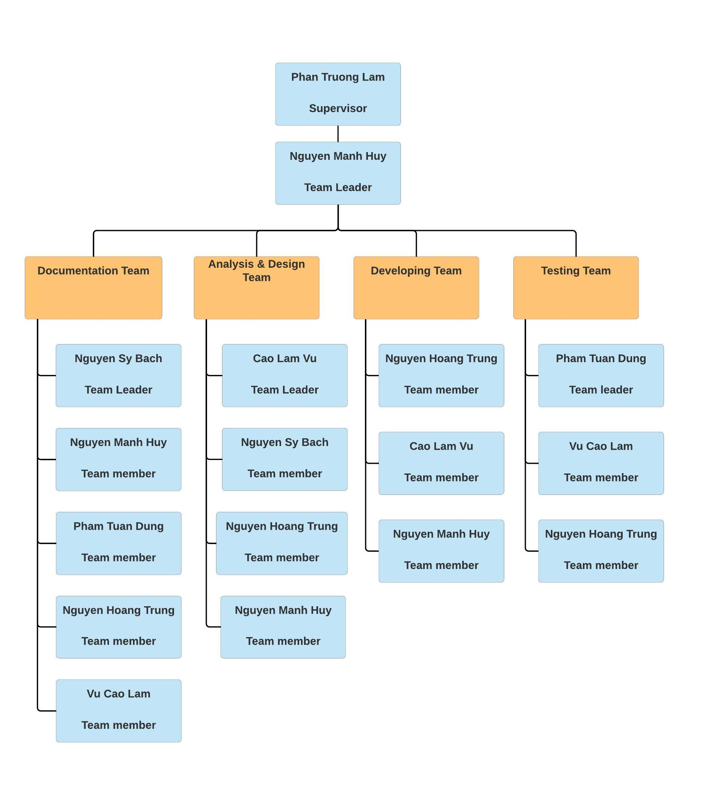
Organizational Structure - 組織構造
PROJECT MANAGEMENT

Slide 12
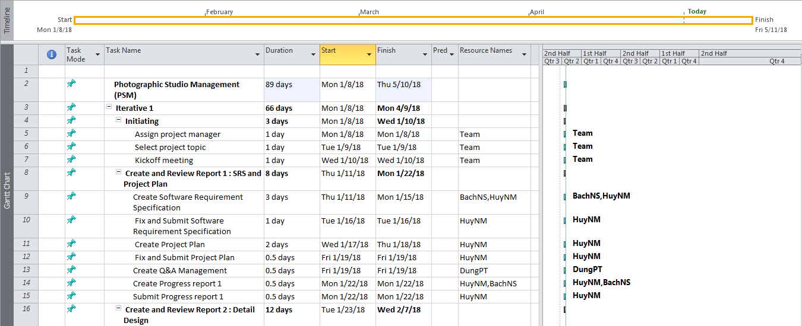
Project Schedule - プロジェクトスジュール
PROJECT MANAGEMENT

Slide 13




Project Tools – プロジェクトツール
PROJECT MANAGEMENT
Tools for project management
DROPBOX

Slide 14
Project Tools – プロジェクトツール
PROJECT MANAGEMENT
Tools for developing

Slide 15
Risk Management - リスク管理
PROJECT MANAGEMENT
No | Name | Root Cause | Probability | Avoidance plan | Contingency plan | Impact
1 | Team don’t keep the deadline on time. | Members lack of responsibility, sick. Lack of management. | Medium | Make rules and penalties for people who doesn’t meet the deadline. | Working overtime to complete on time | High
2 | Requirement changed while project is processing. | SRS is not provide all information about user requirement such as: lack of customer’s requirement, misunderstand requirement of customer. | High | SRS should be review carefully by PM and the Supervisor. Hold all meeting and make minimize effort to change and improve design by requirement changes. | Team members will have meetings with supervisor to analyze the requirement change, and make a specific action to resolve that problem. | High
3 | Delivery does not meet the deadline. | Team member work late, sick or have other family business | High | Assign tasks to suitable team members depending on their strengths and weakness. | Team leader should regularly care about deadline and project schedule to inform members. Break down task to smaller tasks and assign new tasks to team members. | Medium
4 | Lack of knowledge about technology needs for project. | With some member, they lack the knowledge of new technology for doing the assign task. | Medium | Each team member must study to understand the technology, framework, which is needed for project. | Take example form supervisor and self-study Review complete task to make comment for team member. | Medium
5 | Conflict among team members. | Team member doesn't understand each other. | Medium | Plan some games or team building activities to improve teammate’s relationship and to understand each other. Clear role and responsibility between members. | Have a meeting to resolve conflict problems. | High
6 | Data or Source Code Lost. | Delete Brand in GitHub. Delete wrong source code. | Medium | Back up source code carefully. Commit all small tasks after complete to GitHub. | Restore data from backed up data. Restore source code from history versions. | High

Slide 16




Communication management - コミュニケーション管理
PROJECT MANAGEMENT
Time: 6 hours/day, 5 days/week.
Location: Alpha building, room 105R, FPT University Hoa Lac.
Communication:
Supervisor meeting: Twice a week.

Slide 17

SOFTWARE REQUIREMENT SPECIFICATION ソフトウェア要件仕様書

Slide 18
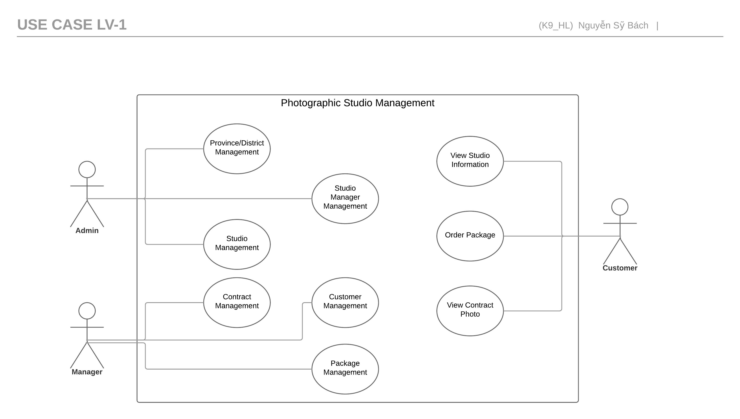
Use-cases overview:
Software Requirement Specification
Admin
Manager
Customer

Slide 19
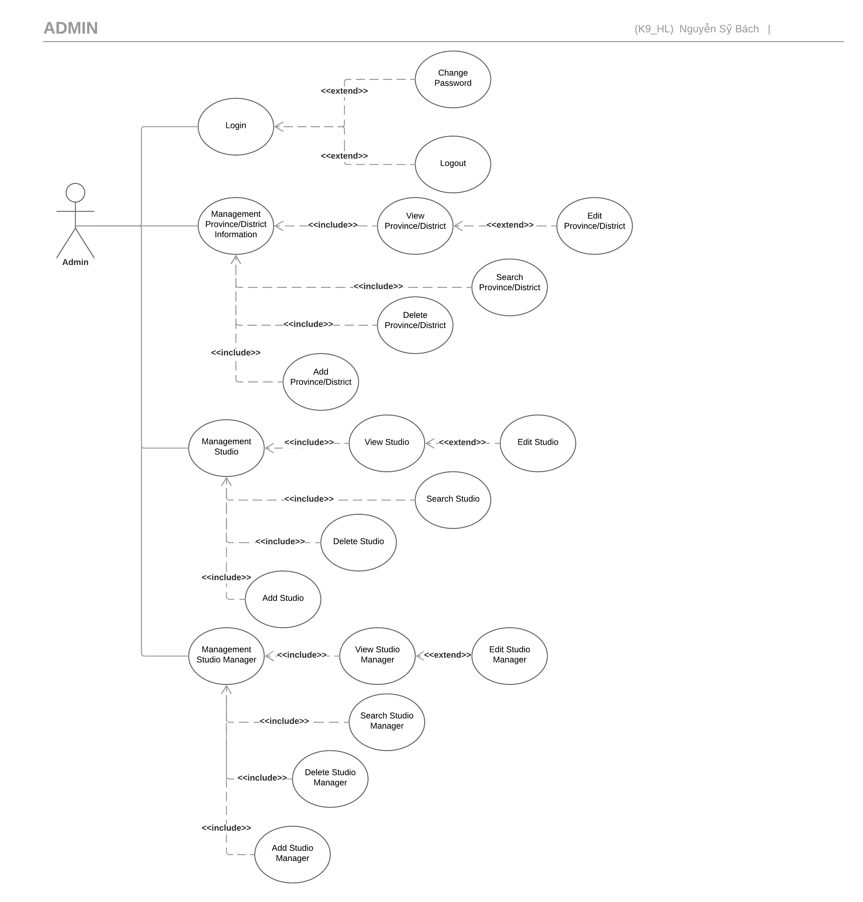

Admin
Software Requirement Specification

Slide 20
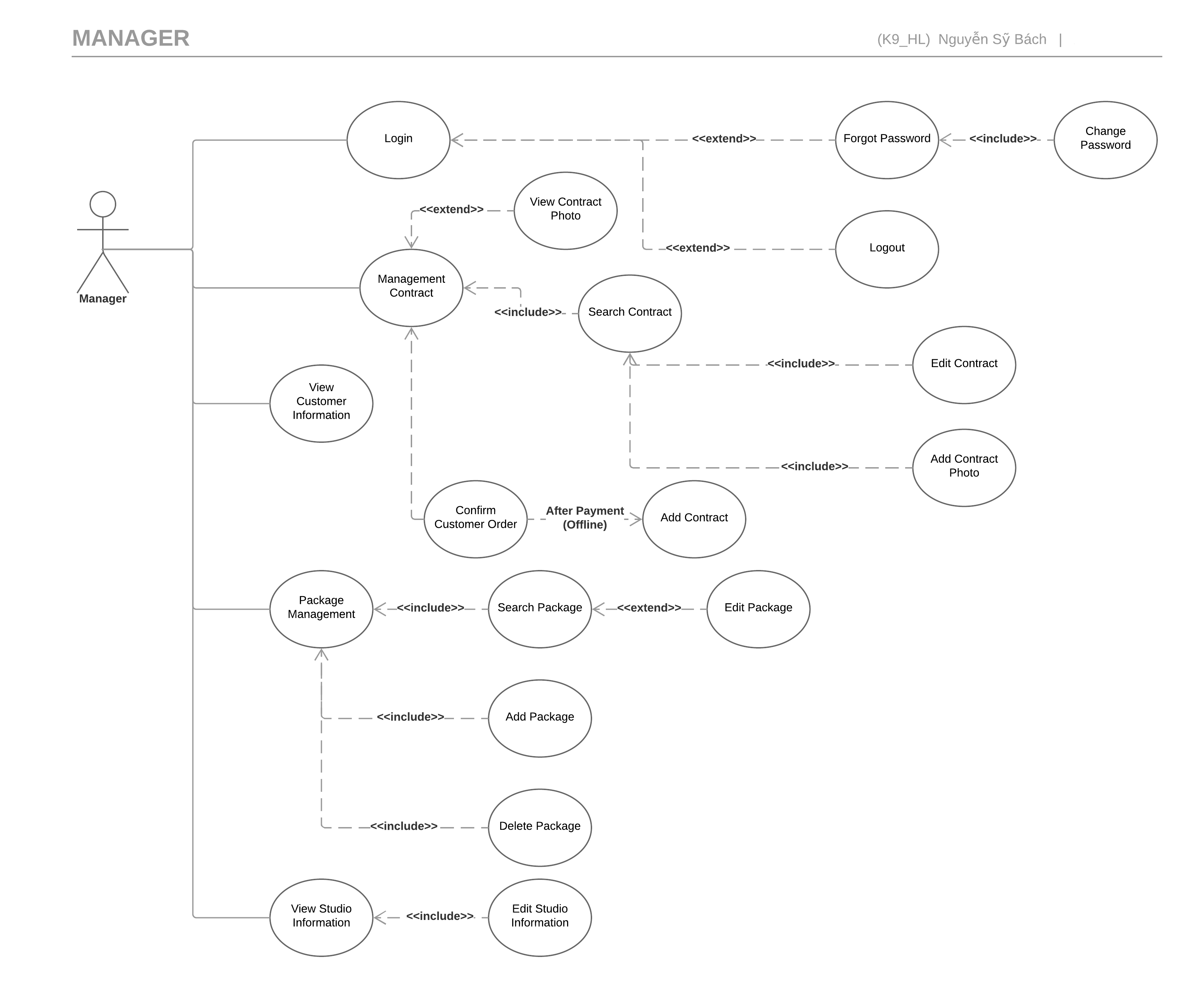
Manager
Software Requirement Specification

Slide 21
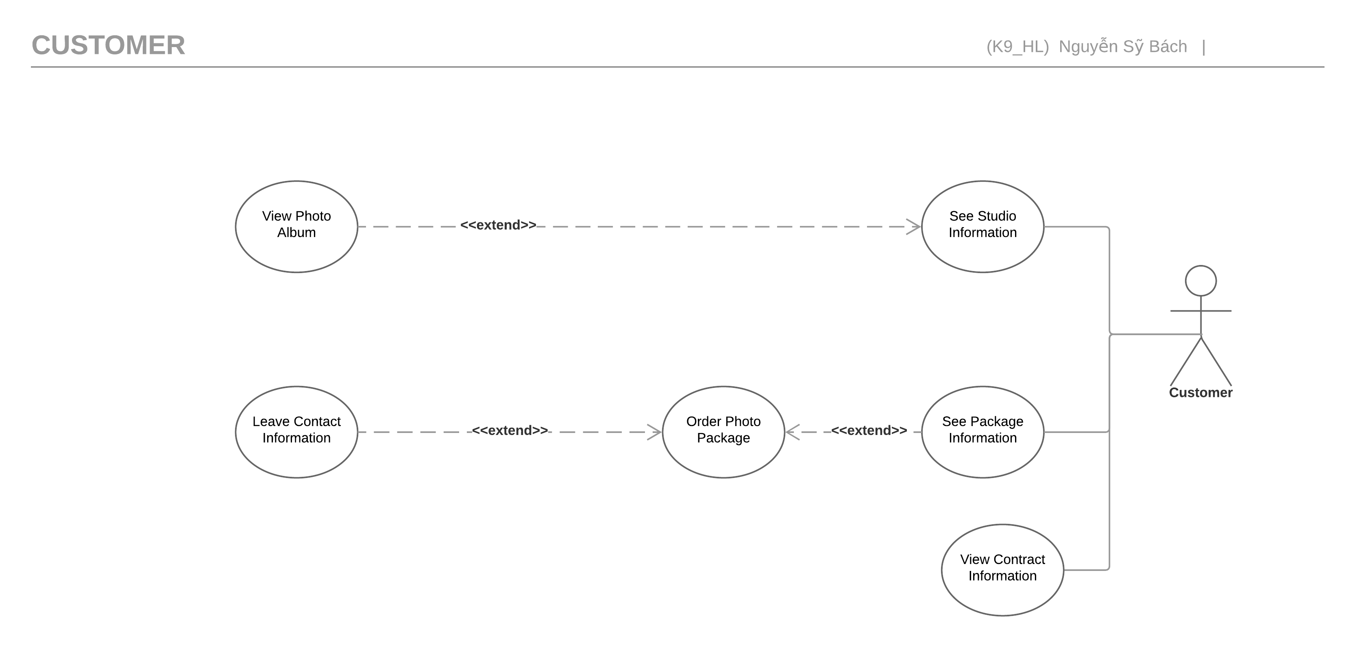
Customer
Software Requirement Specification

Slide 22

Non – Functional Requirement
Software Requirement Specification
Usability
Interface should be beauty, simple, easy-to-use, clear.
Provide an introduction to support users.

Slide 23

Non – Functional Requirement
Software Requirement Specification
Reliability
Search result return must be correctly.
Use’s information must be reliable.
The database must be backed up daily and can be recovered if necessary.

Slide 24

Non – Functional Requirement
Software Requirement Specification
Maintainability
The output of the project must include naming conventions documentations.
Code implementation must be easy to maintain.

Slide 25
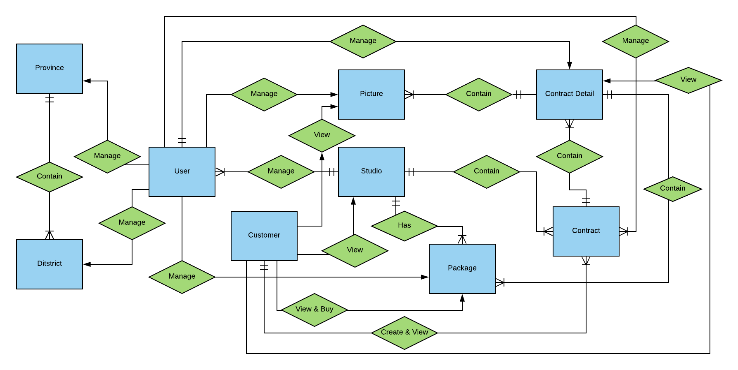
Software Requirement Specification
Entity Relationship Diagram

Slide 26

SOFTWARE DESIGN DESCRIPTION ソフトウェア要件仕様書

Slide 27





Technology & Description
Front End
Back End
SOFTWARE DESIGN DESCRIPTION

Slide 28
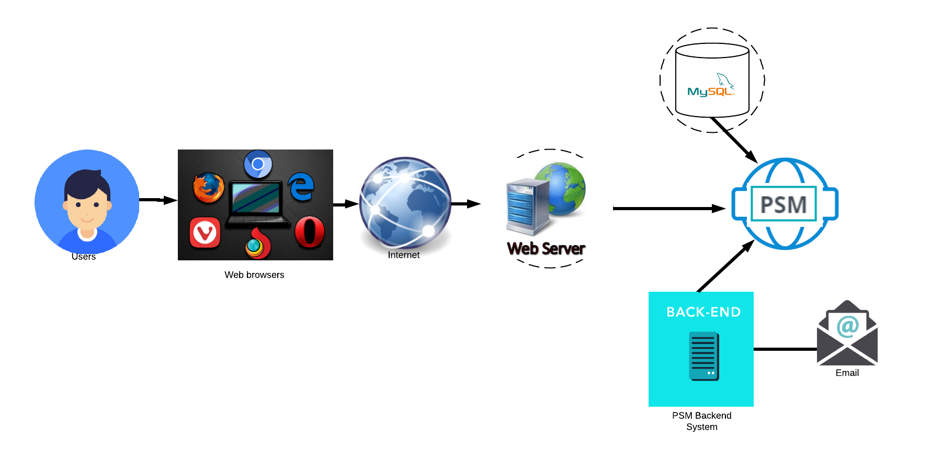
System overview
SOFTWARE DESIGN DESCRIPTION
System Overview Diagram システムの概要

Slide 29
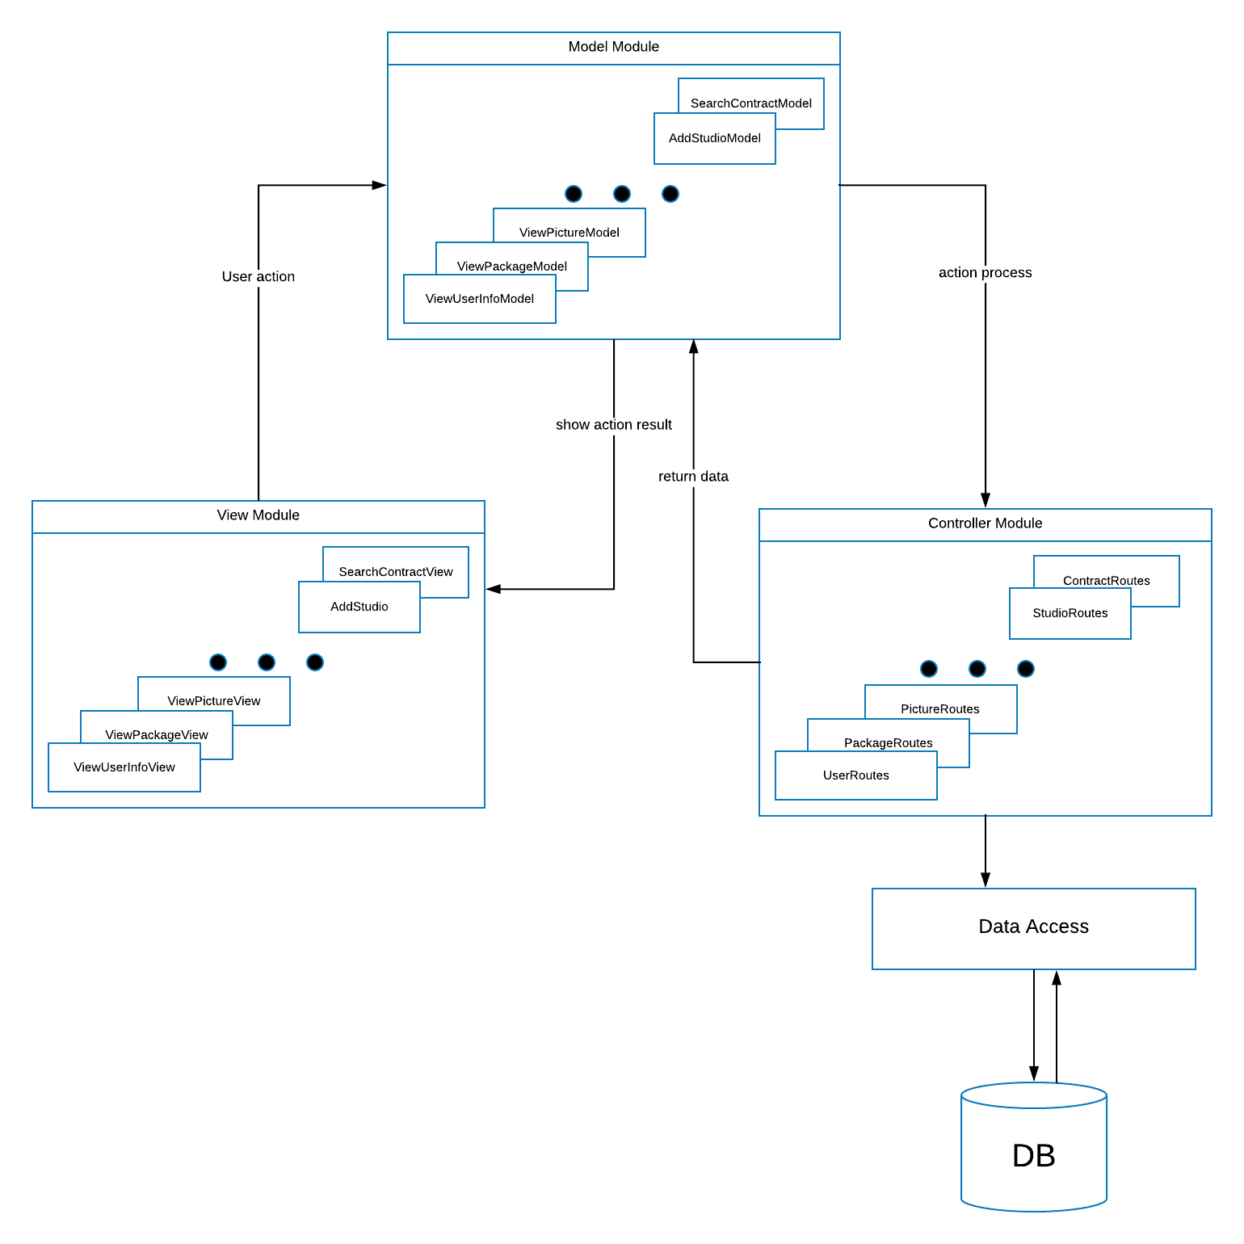
Component diagram
Component Design
SOFTWARE DESIGN DESCRIPTION

Slide 30
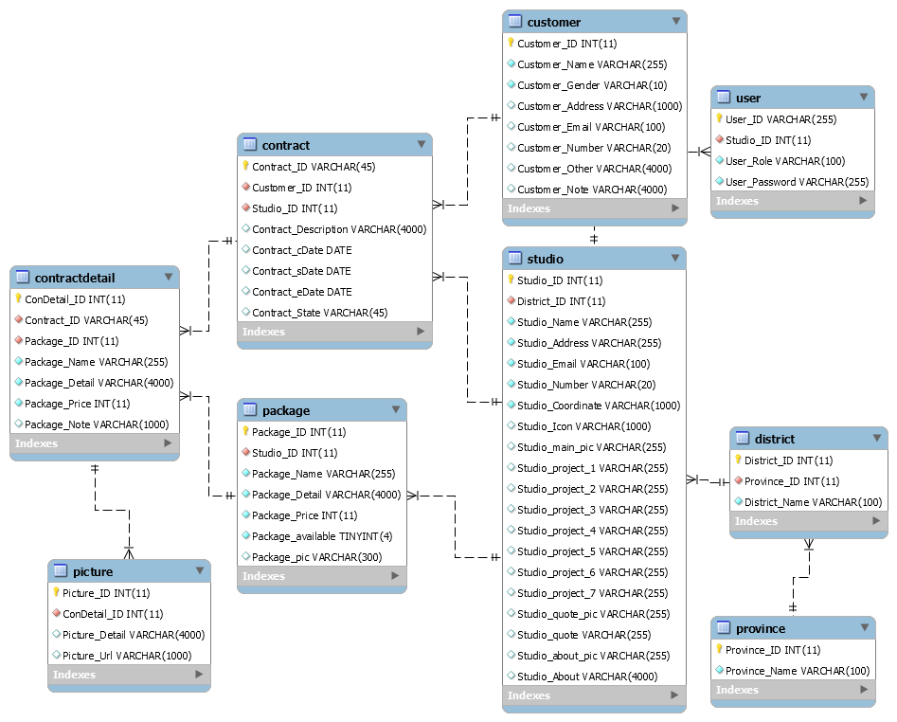
SQL DATABASE DESIGN
SOFTWARE DESIGN DESCRIPTION

Slide 31
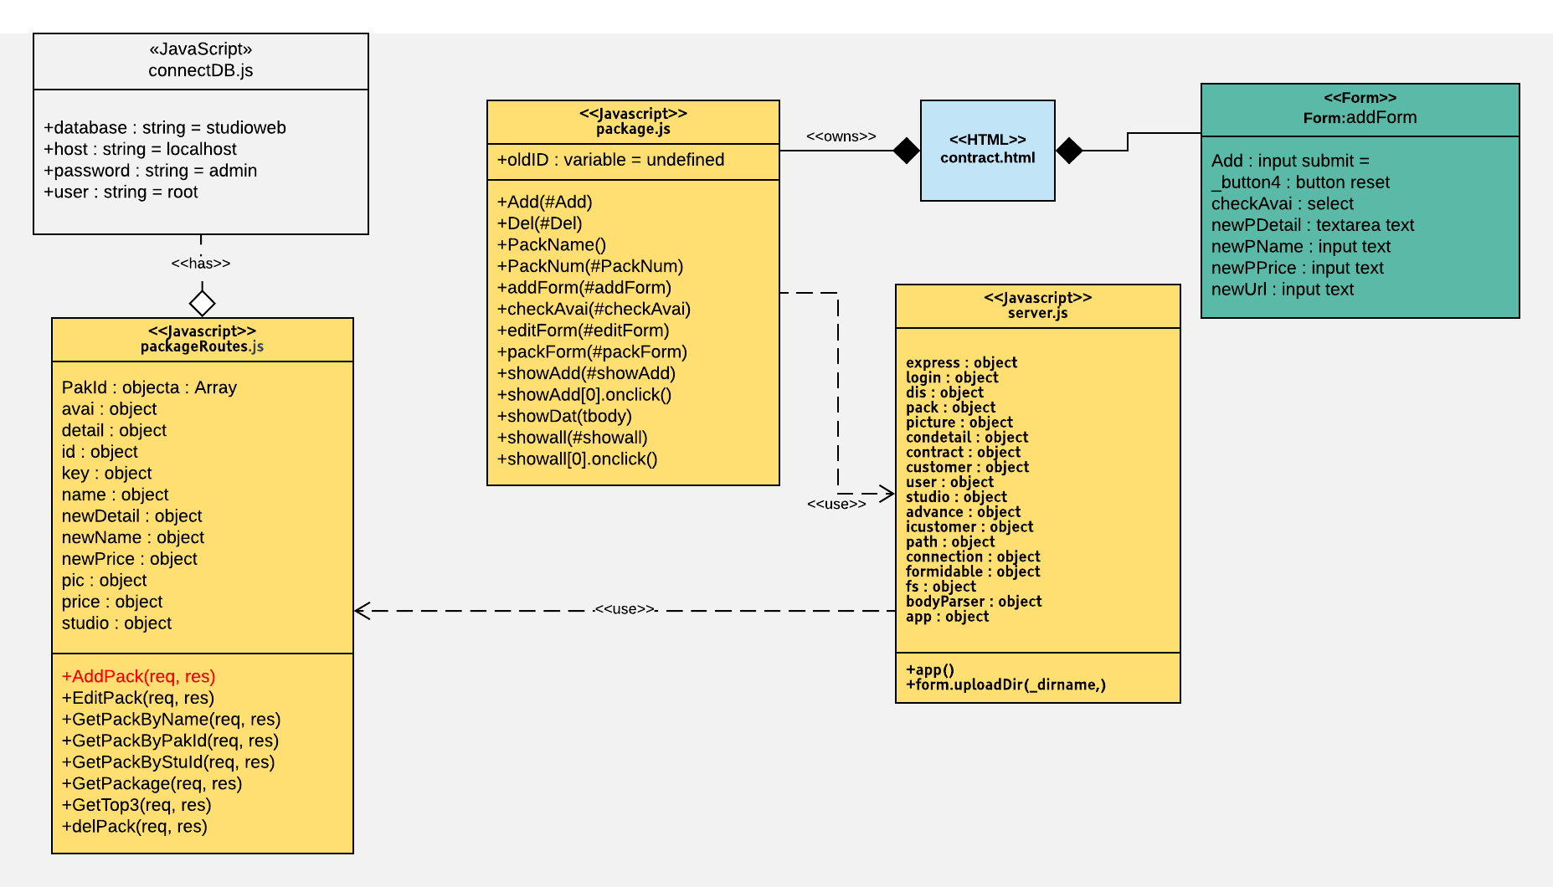
Class diagram
Add Package Class Diagram
SOFTWARE DESIGN DESCRIPTION

Slide 32
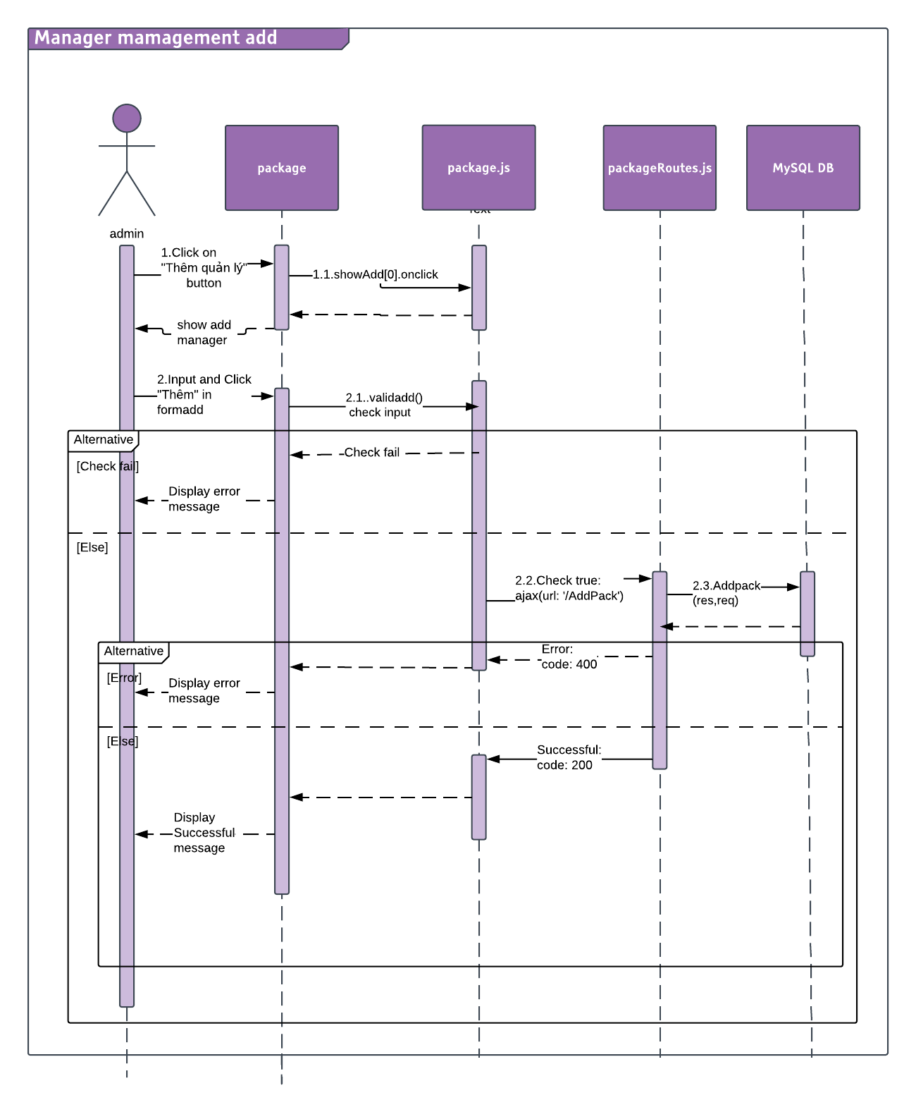
Sequence diagram
Add Package Sequence Diagram
SOFTWARE DESIGN DESCRIPTION

